Slide 1
PA week 10

Slide 2
Overview

Slide 3
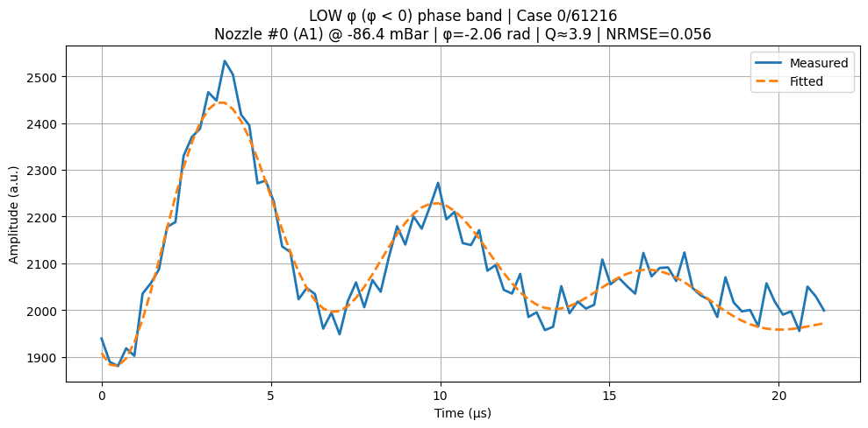
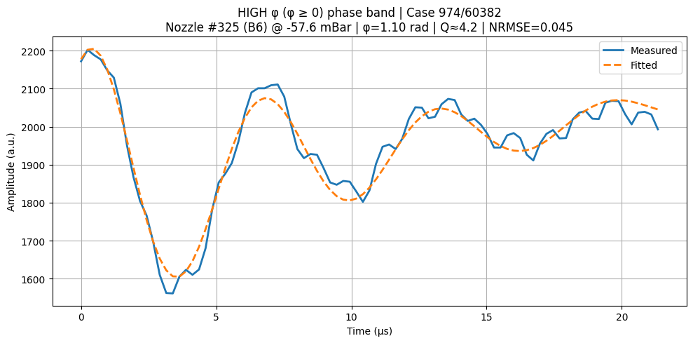

Slide 4
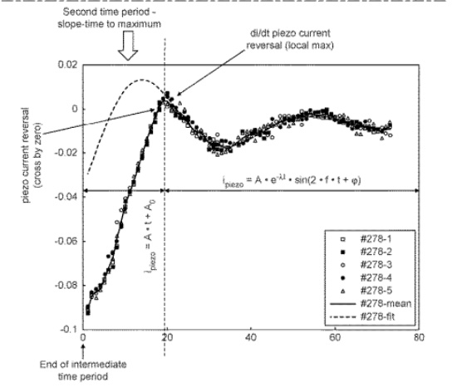

Slide 5

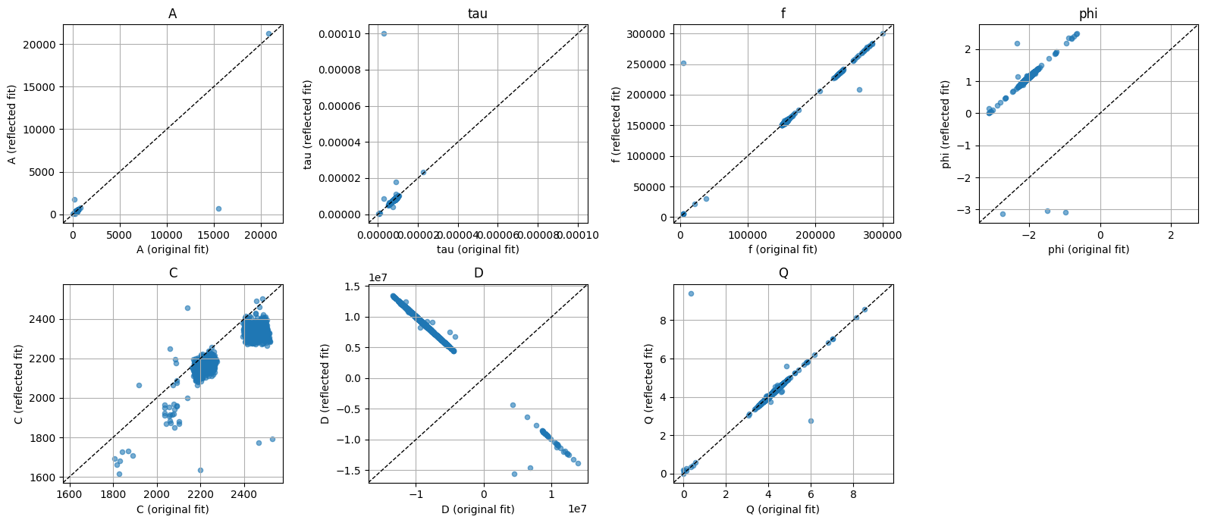
2000 signals with phases below 0

Slide 6
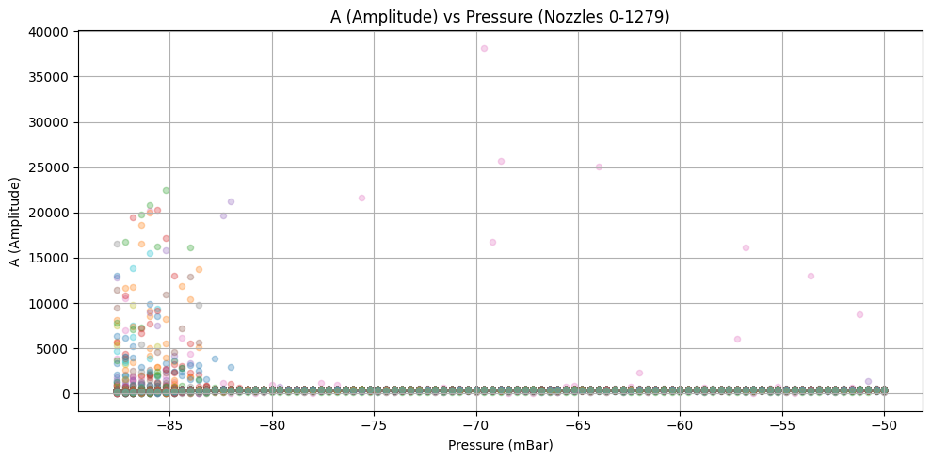

Slide 7
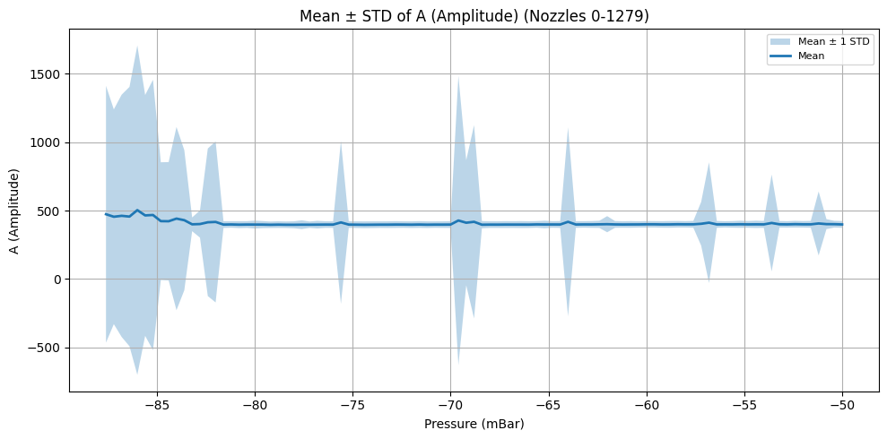

Slide 8
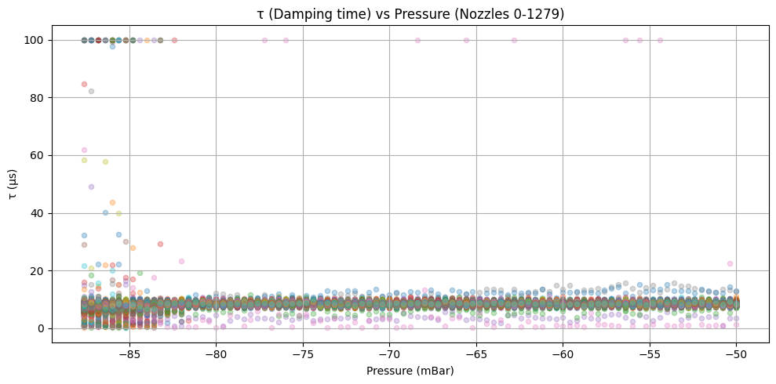

Slide 9
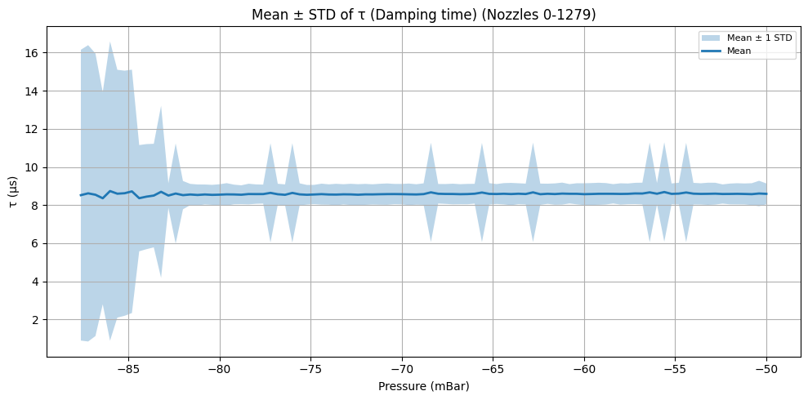

Slide 10
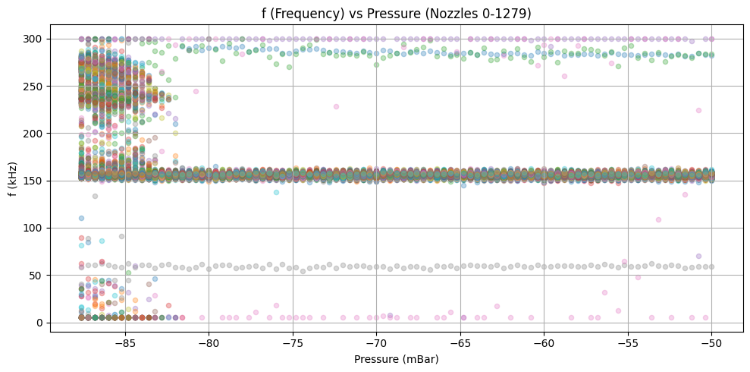

Slide 11
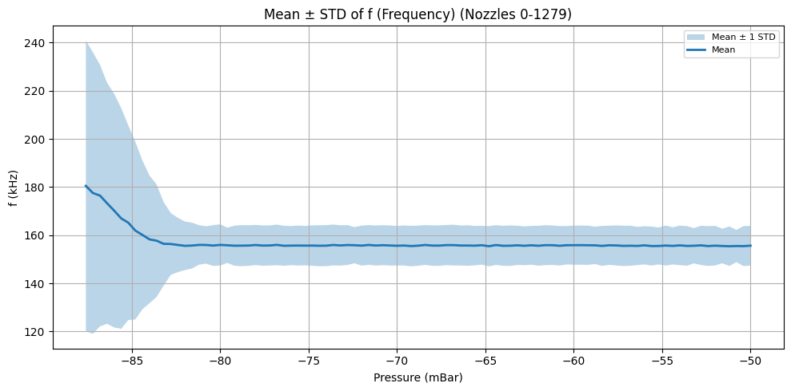

Slide 12
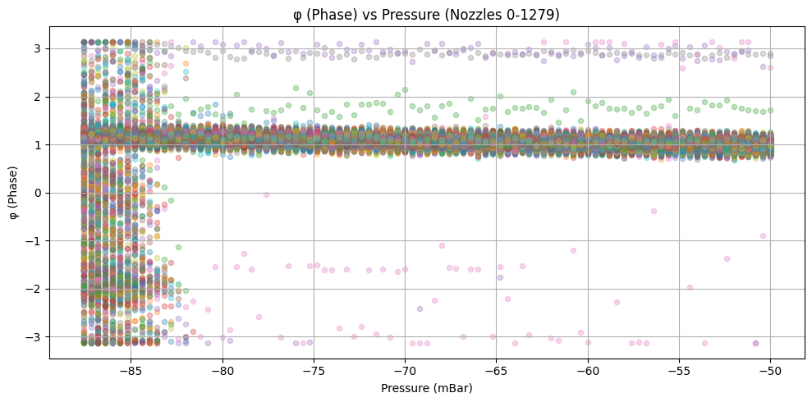

Slide 13
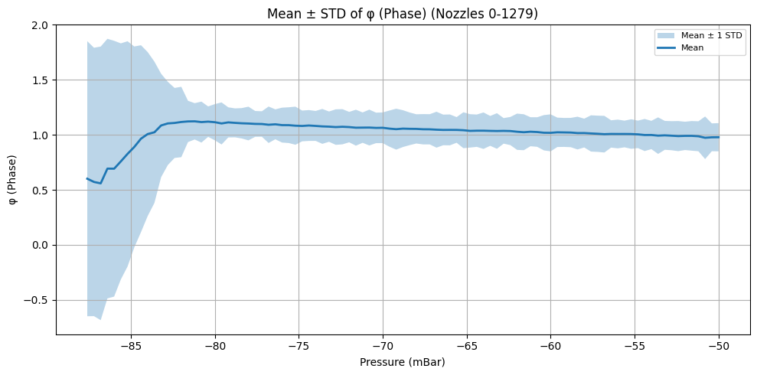

Slide 14
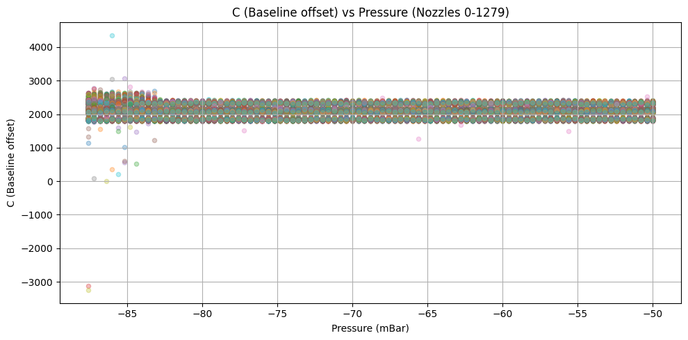

Slide 15
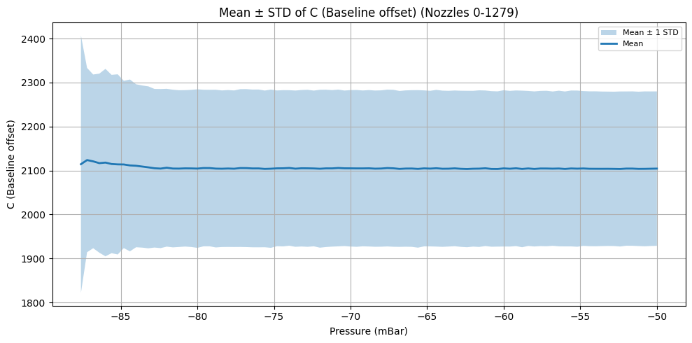

Slide 16
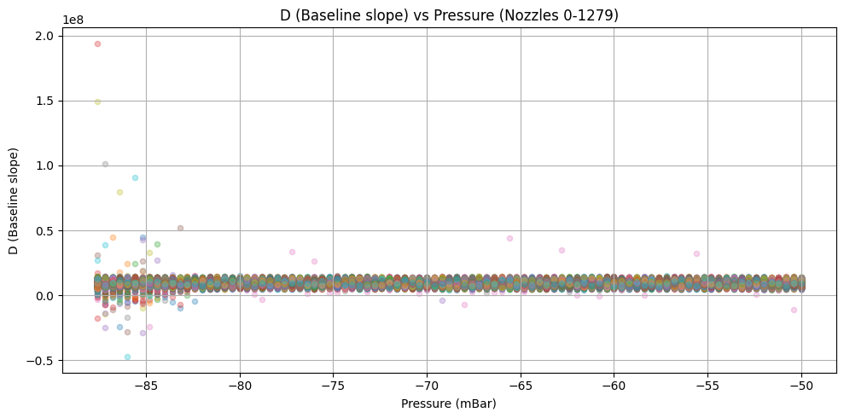

Slide 17
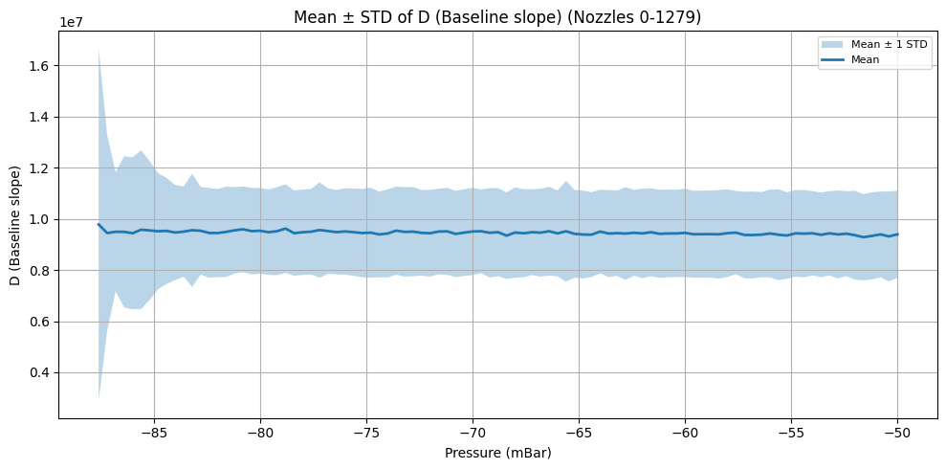

Slide 18
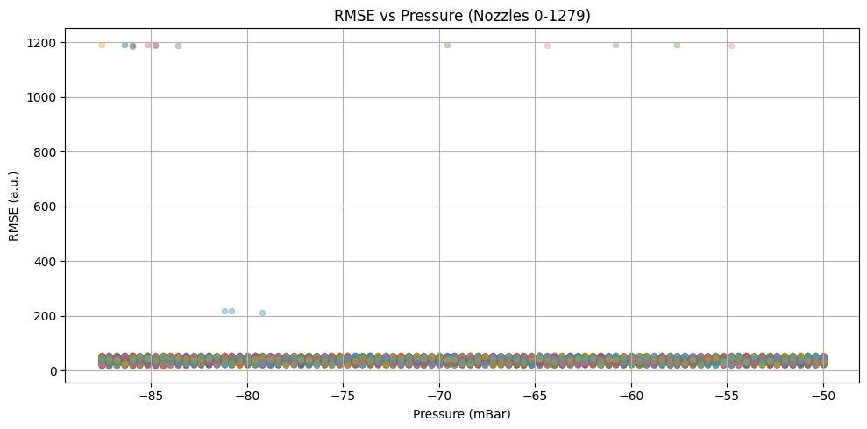

Slide 19
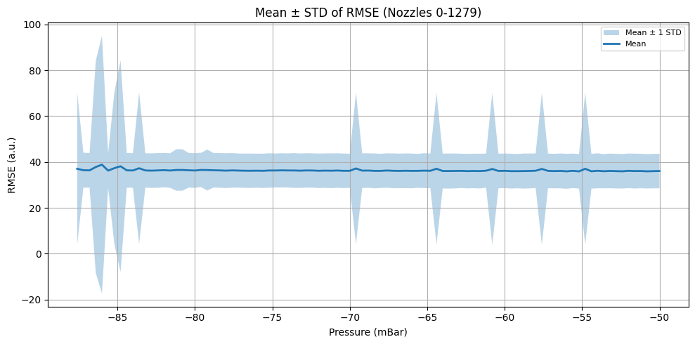

Slide 20
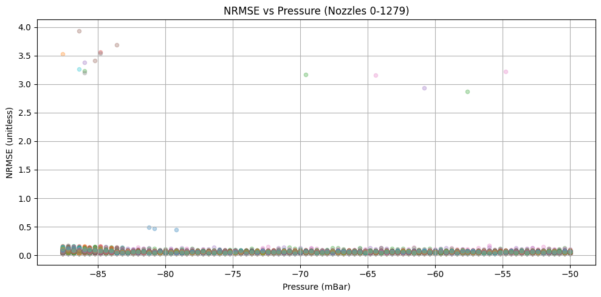

Slide 21
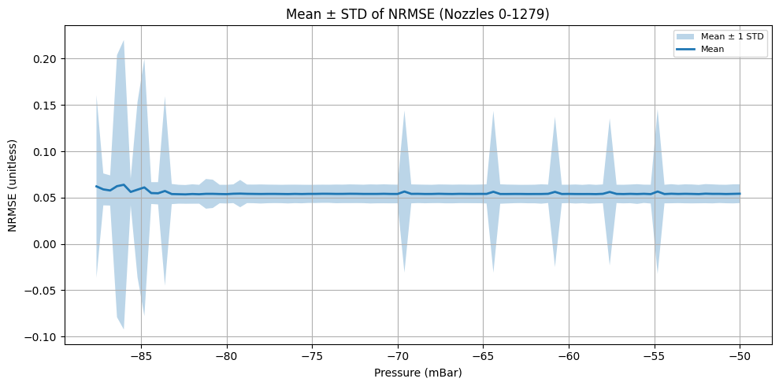

Slide 22
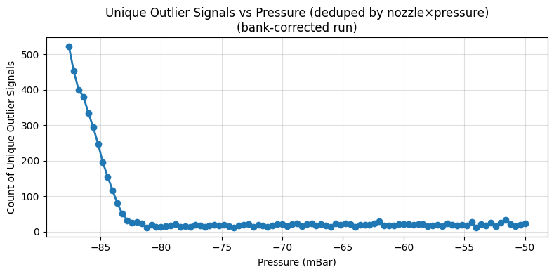
Unique nozzles flagged: 707/1280 (55.23%)
Unique (nozzle × pressure) signals flagged: 4829/121600 (3.97%)

Slide 23
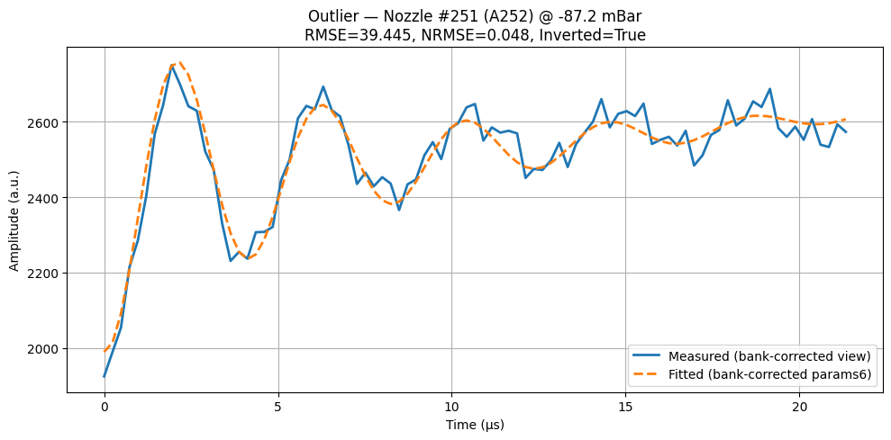
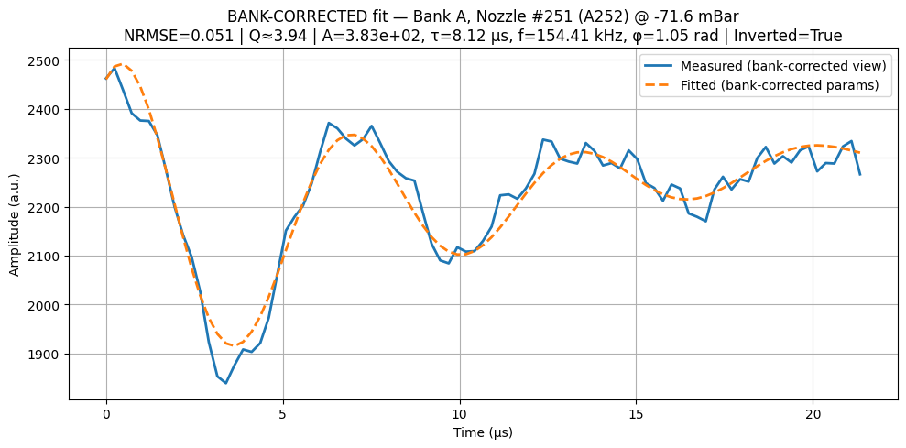

Slide 24
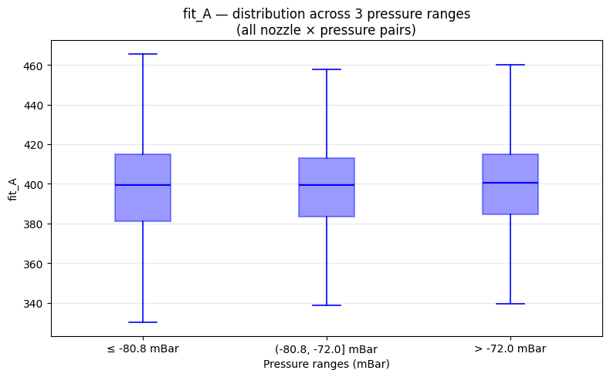

Slide 25
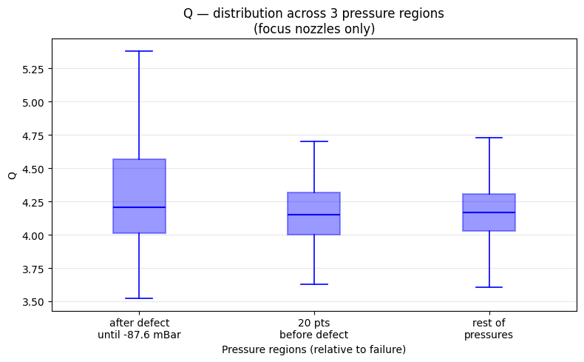

Slide 26
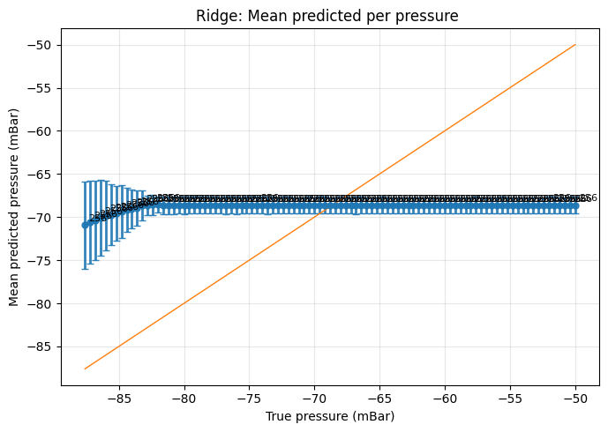
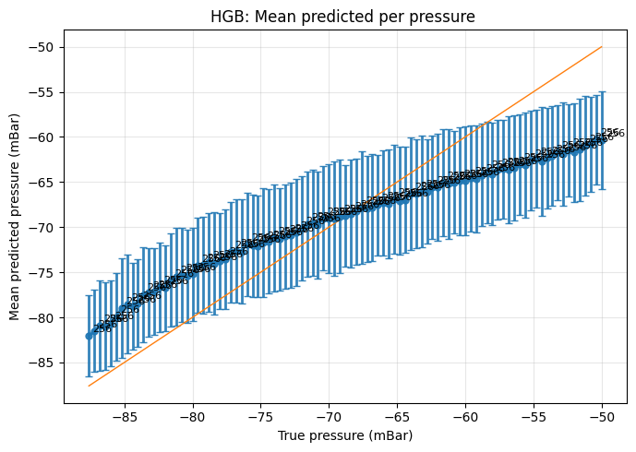

Slide 27
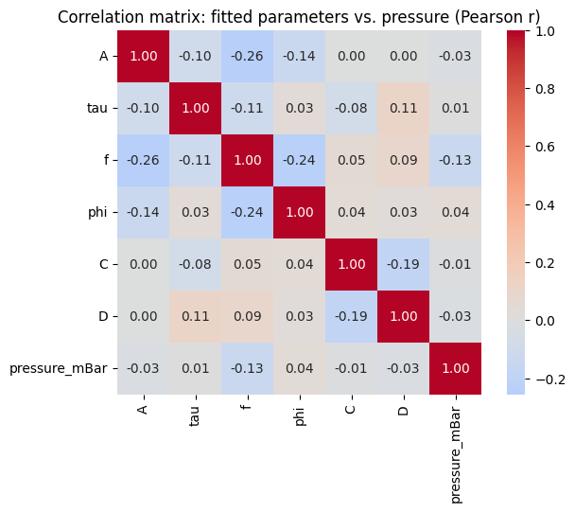
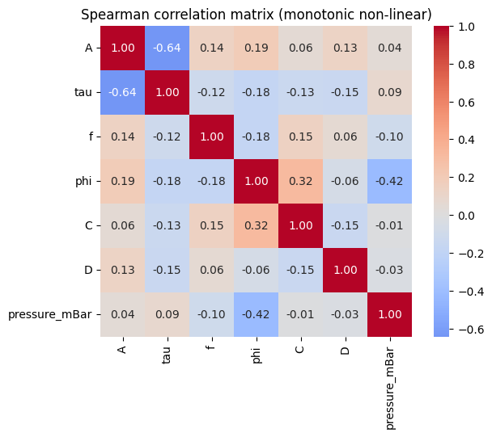

Slide 28
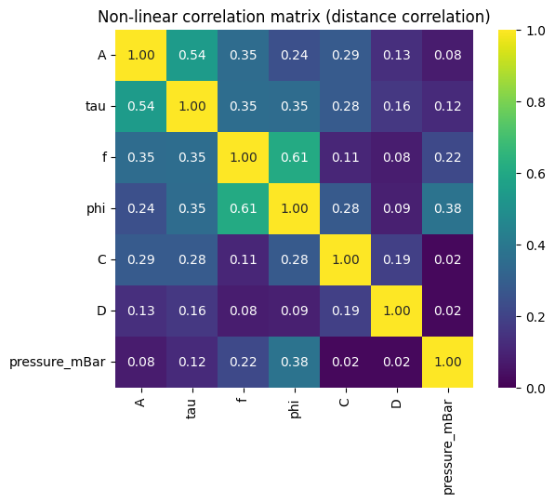
Paire de variables | Distance corr.
f – φ | 0.607
A – τ | 0.545
φ – pressure_mBar | 0.383
τ – f | 0.354
τ – φ | 0.349
A – f | 0.349
A – C | 0.285
τ – C | 0.284
φ – C | 0.281
A – φ | 0.243
f – pressure_mBar | 0.222
C – D | 0.190
τ – D | 0.163
A – D | 0.134
τ – pressure_mBar | 0.120
f – C | 0.106
φ – D | 0.089
f – D | 0.080
A – pressure_mBar | 0.076
D – pressure_mBar | 0.023
C – pressure_mBar | 0.021

